Slide 1


Social Buzz Category Insights

Slide 2


Today's agenda
Project recap
Problem
The Analytics team
Process
Insights
Summary

Slide 3

Company Overview: Introduce Social Buzz as the fastest growing unicorn in the industry.
Purpose: Outline that Accenture is partnering with Social Buzz to scale globally by auditing big data practices, analyzing top content categories, and recommending strategies for a successful IPO.
Project Recap

Slide 4

Problem
Massive Data Volume:
Over 100,000 posts are generated daily on Social Buzz.
This equates to 36.5 million posts in a year.
Data Overload:
The sheer volume of content makes it challenging to extract actionable insights
Focus Area:
Analyzing the top 5 content categories to identify key drivers of user engagement and optimize content strategy.

Slide 5
Process
1
Data Understanding
2
Tool Selection and Data Cleaning
3
Data Modelling
4
Insights and Visualization
5
Communicating Insights

Slide 6

Insights
16 Unique Content Categories
1897 Reactions to the ‘Animal ‘ Category
JANUARY Month with the most Posts

Slide 7
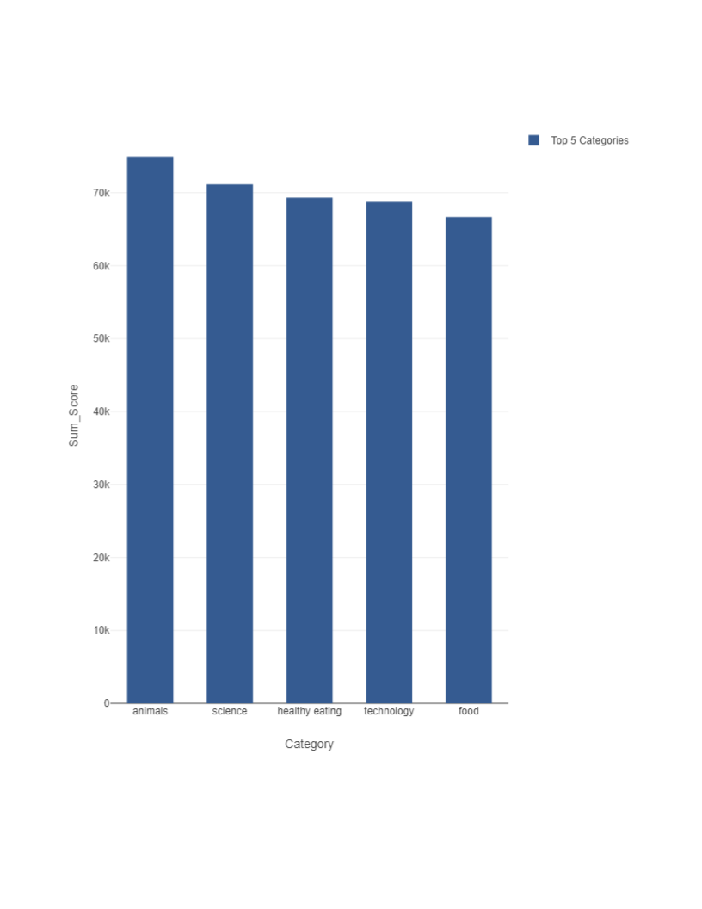

Slide 8

Summary
Our analysis of the social media content data reveals that the leading categories, based on their cumulative scores, are as follows:
Animals - With a total score of 71,242, this category emerged as the most engaging, reflecting a strong interest in content related to animals.
Healthy Eating - Scoring 69,067, this category highlights a significant trend towards health-conscious content, showing a growing audience for nutritional and wellness topics.
Technology - At 68,521, technology remains a key area of interest, indicating ongoing engagement with innovations and tech developments.
Science - The science category accumulated a score of 66,549, demonstrating substantial audience engagement with scientific discoveries and information.
Culture - Closing the top five, culture scored 64,952, reflecting an interest in diverse cultural content and storytelling.

Slide 9
Thank you!
ANY QUESTIONS?

